Slide 1
Entity Framework Core
EF Core Database First

Slide 2

Lesson Objectives
EF Core Database First
Entity-Table Mapping
Domain classes and entity classes
DbContext, DbSet
Entity States in Entity Framework Core

Slide 3
EF Core Database First
Section 1

Slide 4
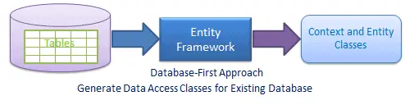
What is EF Core Database First?
start with an existing database and generate the entity classes and DbContext based on the database schema.
allows to work with an existing database and leverage the power of EF Core to perform CRUD operations and query the database.

Slide 5
Entity-Table Mapping
Each entity in EDM is mapped with the database table.
Column of the table is mapped to Property of the Entity
Table name, column name, data type are generated automatically, based on table schema.

Slide 6
Domain classes and entity classes (1)
From a domain-driven design (DDD) perspective, domain classes:
Represent the core business entities and concepts of the application.
These classes encapsulate the behavior and state of the domain and are independent of any persistence concerns.
Domain classes typically reflect the business logic and rules of the application and are designed to solve specific business problems

Slide 7
Domain classes and entity classes (2)
Entity classes in Entity Framework Core:
Represent the objects that are persisted in the database.
These classes map to database tables and are used to perform CRUD operations and query the database.
Entity classes often have additional attributes or configurations to define the mapping between the class properties and the database columns.

Slide 8
Domain classes and entity classes (3)
In many cases, domain classes and entity classes can be the same, especially in smaller applications or when following a simple CRUD-based approach.
However, in more complex scenarios, it is common to have separate domain classes and entity classes to maintain a clear separation of concerns.

Slide 9
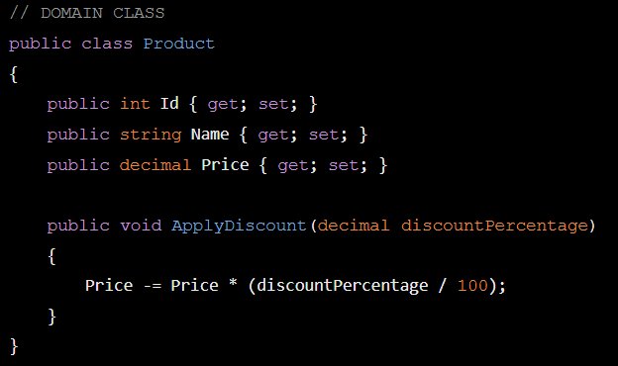
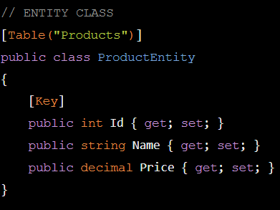
Domain classes and entity classes (4)
Product domain class that represents a core business entity.
It has properties like Id, Name, and Price, and a method ApplyDiscount to apply a discount to the product price.
ProductEntity entity class that represents the database table.
It has the same properties as the Product class, but with additional attributes like [Table("Products")]
and [Key] to define the table name and primary key.

Slide 10
Create context from database
Session 2

Slide 11
Create context from database
EF Core does not support visual designer for DB model and wizard to create the entity and context classes similar to EF 6.
So, we need to do reverse engineering using the Scaffold-DbContext command.
Step 1: Create entity and context classes for the database
Step 2: Use Scaffold-DbContext to create a model based on your existing database

Slide 12
Scaffold-DbContext Command
The following parameters can be specified with Scaffold-DbContext in Package Manager Console:
Scaffold-DbContext [-Connection] [-Provider] [-OutputDir] [-Context] [-Schemas>] [-Tables>]
[-DataAnnotations] [-Force] [-Project] [-StartupProject] [<CommonParameters>]

Slide 13
Scaffold-DbContext Command
In Visual Studio, select menu Tools -> NuGet Package Manger -> Package Manger Console and run the following command:
PM> Scaffold-DbContext "Server=.\SQLExpress;Database=DBName;Trusted_Connection=True;" Microsoft.EntityFrameworkCore.SqlServer -OutputDir Models

Slide 14
DbContext
Section 3

Slide 15
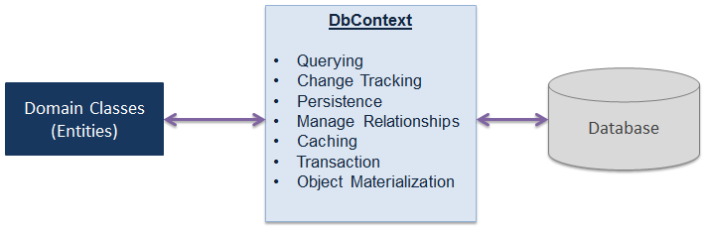
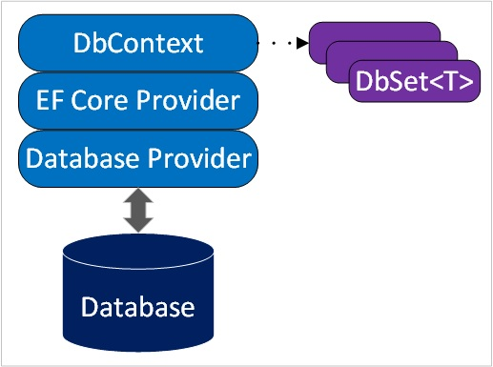
DbContext
A bridge between domain or entity classes and the database.

Slide 16
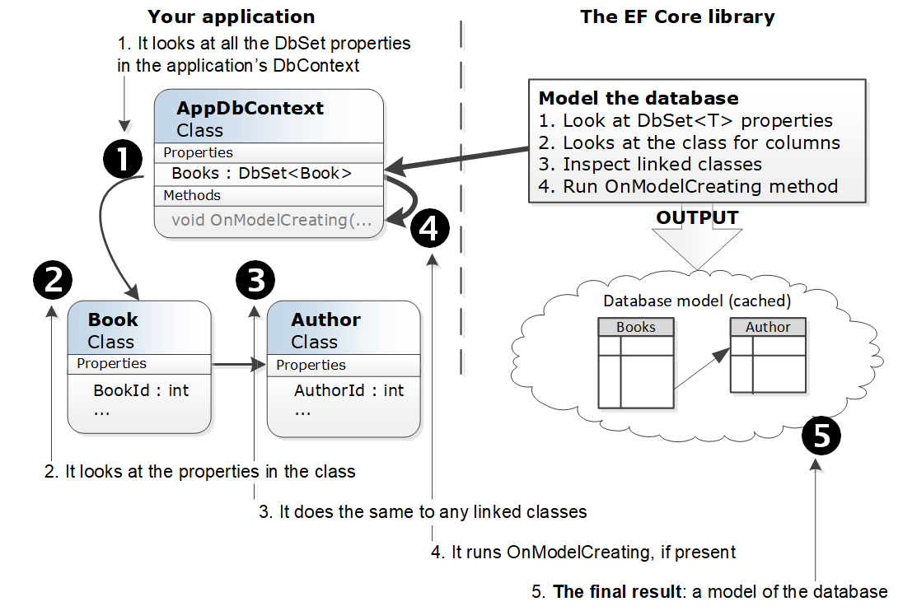
DbContext and DbSet work with
The process that EF Core goes through the first time use application’s DbContext

Slide 17
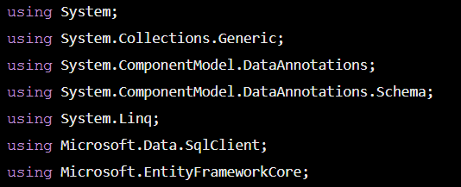
Create a context class (1)
Step 1: Add the necessary header directives and using directives to the code snippet:

Slide 18
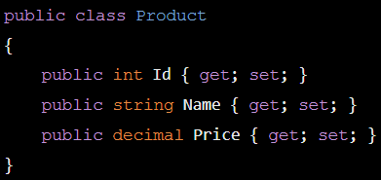
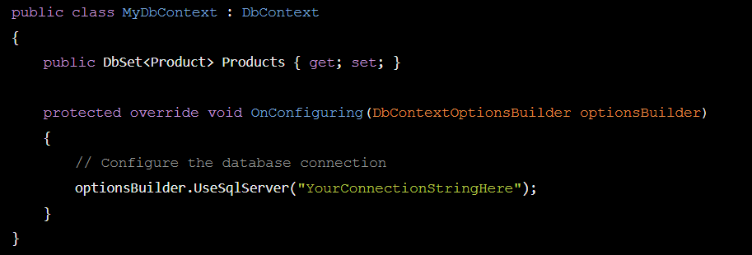
Create a context class (2)
Step 2: Define your entity class(es).
For this example, let's create a simple Product entity:
Step 3: Create your context class that derives from DbContext:
a DbSet property called Products to represent the Product entity in the database.
The OnConfiguring method is overridden to configure the database connection.
Replace "YourConnectionStringHere" with your actual SQL Server connection string.

Slide 19
DbContext Activities
Querying
Converts LINQ-to-Entities queries to SQL query and sends them to the database.
Change Tracking
Keeps track of changes that occurred on the entities after querying from the database.
Persisting Data
Performs the Insert, Update and Delete operations to the database, based on entity states.

Slide 20
DbContext Activities
Caching
Provides first level caching by default.
It stores the entities which have been retrieved during the life time of a context class.
Manage Relationship
Manages relationships using CSDL, MSL and SSDL.
Object Materialization
Converts raw data from the database into entity objects.

Slide 21
DbContext Methods
Entry
Gets an DbEntityEntry for the given entity.
The entry provides access to change tracking information and operations for the entity.
SaveChanges
Executes INSERT, UPDATE and DELETE commands to the database for the entities with Added, Modified and Deleted state.
SaveChangesAsync
Asynchronous method of SaveChanges()

Slide 22
DbContext Methods
Set
Creates a DbSet<TEntity> that can be used to query and save instances of TEntity.
OnModelCreating
Override this method to further configure the model that was discovered by convention from the entity types exposed in DbSet<TEntity> properties on your derived context.

Slide 23
DbContext Properties
ChangeTracker
Provides access to information and operations for entity instances that this context is tracking.
Configuration
Provides access to configuration options.
Database
Provides access to database related information and operations.

Slide 24
DbSet
Section 4

Slide 25
DbSet
Represents an entity set that can be used for Create, Read, Update, and Delete operations. (CRUD)
Map to database table or view.

Slide 26
DbSet Methods
Add
Input: entity object
Output: added entity
Description: Adds the given entity to the context with the Added state. When the changes are saved, the entities in the Added states are inserted into the database. After the changes are saved, the object state changes to Unchanged.
Example: dbcontext.Students.Add(studentEntity)

Slide 27
DbSet Methods
Create
Input: Non
Output: entity object
Description: Creates a new instance of an entity for the type of this set. This instance is not added or attached to the set. The instance returned will be a proxy if the underlying context is configured to create proxies and the entity type meets the requirements for creating a proxy.
Example: var newStudentEntity = dbcontext.Students.Create();

Slide 28
DbSet Methods
Remove
Input: entity object
Output: entity object
Description: Marks the given entity as Deleted. When the changes are saved, the entity is deleted from the database. The entity must exist in the context in some other state before this method is called.
Example: dbcontext.Students.Remove(studentEntity);

Slide 29
DbSet Methods
Find
Input: params object[] keyValues
Output: entity object
Description: Uses the primary key value to find an entity tracked by the context. If the entity is not in the context, then a query will be executed and evaluated against the data in the data source, and null is returned if the entity is not found in the context or in the data source. Note that the Find also returns entities that have been added to the context but have not yet been saved to the database.
Example: Student studEntity = dbcontext.Students.Find(studentId);

Slide 30
DbSet Methods
Attach
Input: entity object
Output: entity which was passed as parameter
Description: Attaches the given entity to the context in the Unchanged state.
Example: dbcontext.Students.Attach(studentEntity);

Slide 31
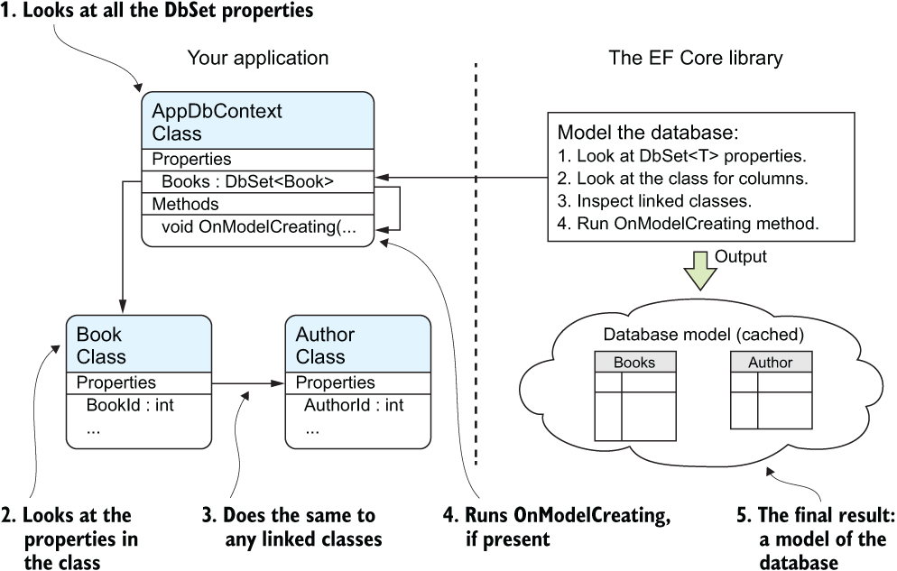
DbContext and DbSet work with

Slide 32
CRUD Operations in Entity Framework Core

Slide 33
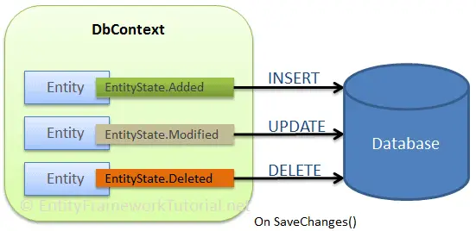
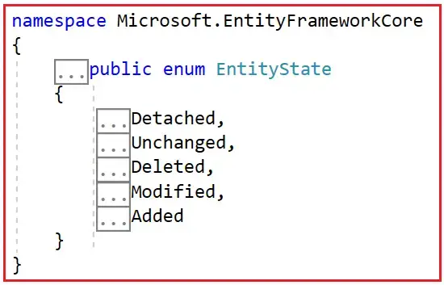
Saving Data (in Connected Scenario)
An entity contains data in its scalar property will be either inserted or updated or deleted based on its EntityState

Slide 34
Entity States in EF Core
The Entity Lifecycle in EF Core describes how an Entity is created, added, modified, deleted, etc.
Entities have many states during their lifetime.
EF Core maintains the state of each entity during its lifetime.
Each entity has a state based on the operation performed via the context class (the class derived from the DbContext class).
Each entity tracked by the DbContext has a state, which indicates how the entity should be processed during a SaveChanges() operation.
The entity state is represented by an enum called EntityState in EF Core

Slide 35
Entity States in EF Core
The Entity State represents the state of an entity. An entity is always in any one of the following states.
Added: The entity is tracked by the context but does not yet exist in the database.
Deleted: The entity is tracked by the context and exists in the database. It has been marked for deletion from the database but has not yet been deleted.
Modified: The entity is tracked by the context and exists in the database. Some or all of its property values have been modified but not updated in the database.
Unchanged: The entity is tracked by the context and exists in the database. Its property values have not changed from those in the database.
Detached: The entity is not being tracked by the context.

Slide 36
Entity Lifecycle in EF Core
The entity lifecycle involves different states and transitions that determine how entities interact with the DbContext and, ultimately, to the database
The change in the entity state from the Unchanged to the Modified state is the only state automatically handled by the context class.
All other changes must be made explicitly using the proper DbContext class methods

Slide 37
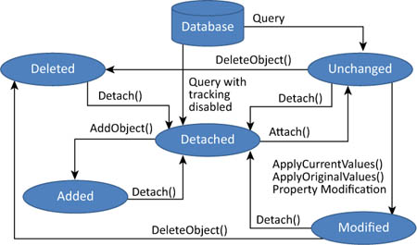
Entity Lifecycle in EF Core

Slide 38
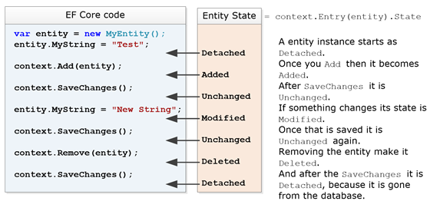
Entity Lifecycle in EF Core

Slide 39
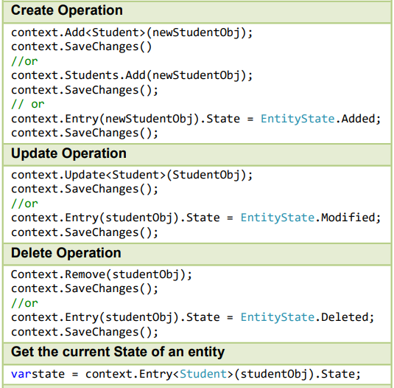
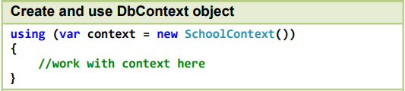
EF Core - Working with DbContext

Slide 40
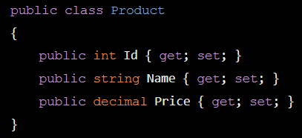
Example
Step 1 vs Step 2

Slide 41
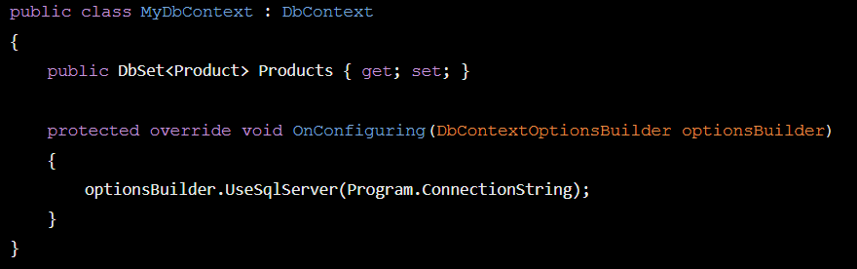
Step 3

Slide 42
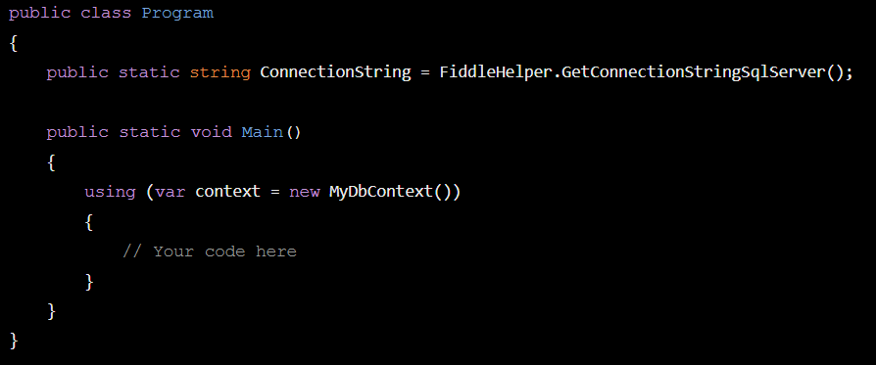
Step 4 (in Programing class)

Slide 43
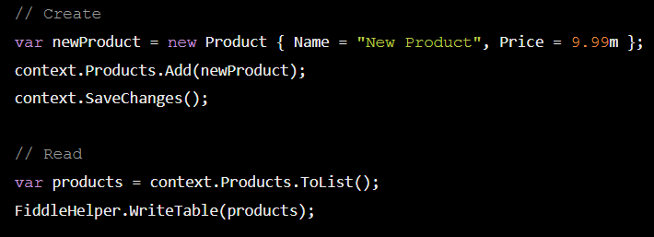
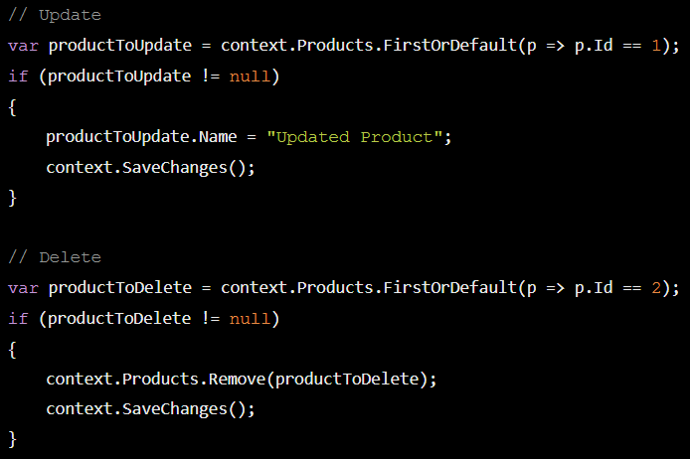
The CRUD operations
the FiddleHelper.WriteTable method to display the list of products after performing the CRUD operations.

Slide 44

Thank you

